Slide 1


The inner workings of “Predator”
Cybersecurity Technologies & governance
Full-time 2022-2023
DOURACHALIS FILIPPOS
ARGYROPOULOS CHRISTOS

Slide 2
Summary
Predator is a Spyware, a type of malware meant to collect sensitive information from infected devices. Such information includes, but is not limited to, microphone and camera captured data, keylogging etc.
Developed by Cytrox, member of Intellexa Alliance, and sold mainly to government-based actors as a Spyware-as-a-Service (SaaS). Pitched as a “Remote Mobile Extraction System” by Intellexa
Starting price of 13.600.000€, including:
1-click exploit for iOS and Android,
Support for 20 concurrent infections in 1 country
Training
12-month warranty and 24/7 support.
iOS persistence optional. Offered for 2.400.000€
Firstly, a stager payload is delivered, meaning after the initial infection, the rest of the payload is downloaded from a Command & Control (C2) server. Predator is executed continuously and information is exfiltrated. In iOS persistence is achieved

Slide 3







Stages of Infection: an overview
Stage 1
Phishing Campaign
Stage 6
Exfiltration
Links sent to specific targets to initiate infection
Receive commands and launch malicious processes to collect information from the victim's device
Stage 2
Profiling
Stage 5
Loader
Checks determine whether target should be infected or not
Loads next payload stages and partly achieves persistence (in iOS)
Stage 4
Initialization
Stage 3
Exploitation Phase
Predator configurations and additional modules are (down)loaded
Vulnerabilities are exploited and payload is delivered to target

Slide 4
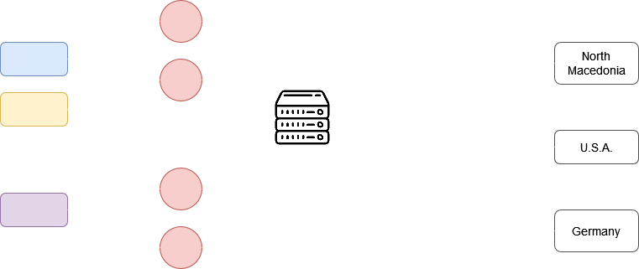
Phishing Campaigns
Phishing links sent to specific targets via SMS, WhatsApp (in iOS’ case) or e-mail (for Android).
Links pointing to attacker-controlled domains that spoofed URL shortening services, news sites, companies or campaigns.
By clicking the link, the target is redirected to a malicious server
Meta and WhoisXML have discovered 300+ Command-and-Control (C2) domains each belonging to Cytrox.
300+ domains
Specifically, WhoisXML noted that these 300+ domains were
Registered to 12 countries
Being resolved to 4 IP addresses
The IPs were spread to 3 countries
12 countries
4 IPs
3 countries

Slide 5
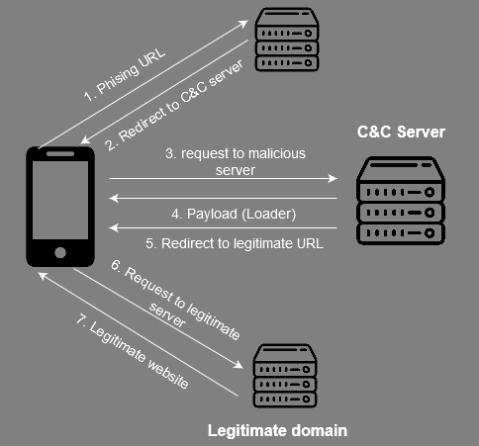
Profiling
Attacks are tailored for particular targets
After being redirected to the malicious server, a check is initiated to decide whether the target is the desired one. Check includes the IP address and device type of the victim.
Malware infection occurs only when the target passes these checks and if the maximum number of concurrent live infections has not been reached.
In any case, target is redirected to a legitimate website to avoid arousing suspicion.

Slide 6


Exploitation Phase
If the profiling check succeeds, the malicious server exploits vulnerabilities to deliver a simple malware, the Predator loader from the domain
Full exploit chains making use of various 0-day as well as n-day vulnerabilities (critical bugs that were not flagged as security issues and thus not patched in all versions)
Exploits similar for both iOS and Android. Worked on fully up-to-date devices
Android
iOS
Google TAG discovered 3 campaigns targeting android devices with phishing link sent via e-mail. These campaigns exploited:
4 Chrome 0-day vulnerabilities
1 Android kernel n-day vulnerability
shorten[.]fi and s.bit-li[.]com acted as phishing links
getupdatesnow[.]xyz, contents-domain[.]com and redirecting[.]page delivered the exploits
No known exploitation campaigns.
Exploits could have made use of vulnerabilities in the iOS kernel and WebKit engine used by Safari browser, since links were opened using this browser in iPhones. This is strictly hypothetical.
Potential iOS and WebKit vulnerabilities can be found in Google’s “0-day in-the-wild” sheet
almasryelyuom[.]com, qwxzyl[.], youtu-be[.]net acted as phishing links

Slide 7
Exploitation - Android
Campaigns delivered a payload containing the ALIEN loader, exploiting the following vulnerabilities:
CVE-2021-38000 (Chrome Intents Logic Flaw)
An HTTP 302 redirection to the intent URL specified (in this case Sbrowser), which then opens another URL in the external application.
After that, the exploit used n-day vulnerabilities affecting Sbrowser to deliver the payload
CVE-2021-37973
(Use after free in Portals API)
Used in conjunction with CVE-2021-37976 after an initial unknown RCE exploit.
Chrome sandbox escape after loading an ELF binary.
Another unknown exploit downloaded in /data/data/com.android.chrome/p.so after the sandbox escape to elevate privileges and install ALIEN
CVE-2021-37976
Information leak in memory_instrumentation.mojom.Coordinator resulted in a bypass of the Address Space Layout Randomizer (ASLR) by leaking memory addresses
CVE-2021-1048
(Android kernel refcount increment on mid-destruction file)
Bug in epoll() system call used to escape the sandbox and escalate privileges.
Patch not incorporated in most android devices due to it being a n-day vulnerability
CVE-2021-38003
(JSON.stringify leaks TheHole value)
JavaScript leaked TheHole value which can be used to cause memory corruption and lead to RCE due to special handling of TheHole values in JSMaps. Used alongside the previous Linux-kernel bug

Slide 8
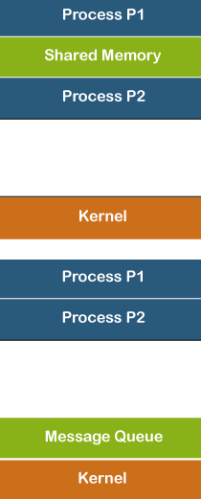
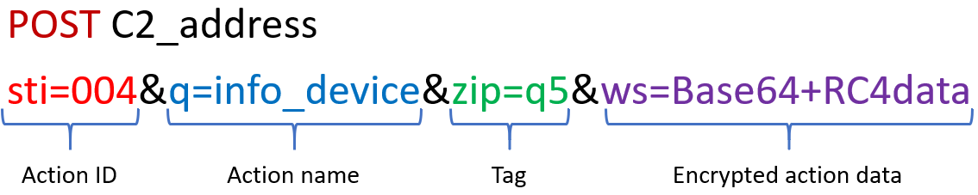
ALIEN: The Trojan Loader
Likely a variation of the known banking Trojan, fork of Cerberus. Rented to customers (MaaS).
Includes RAT functionality. ALIEN lives inside multiple privileged processes and receives commands from Predator over Inter-Process Communication (IPC). Capabilities include:
Recording audio
Adding CA certificates
Hiding apps
And much more.
IPC Models
ALIEN’s original C2 communication protocol:

Slide 9
Initialization
Initialized by unknown exploit in iOS. In Android we estimate it could be the exploits mentioned before
Invoked main() with kernel process task port and PID as arguments
Loads frozen python module named “loader”
Loads a python 2.7 bundled runtime
Android
iOS
Passes main's arguments to shared constant “SHMEMFD_VSS”
Adds extra objects to the runtime (predutils, predconfig, injector, pc2, recorder, voio_recorder)
Calls kmem_init with main's args to enable Predator 1st stage
Adds extra objects to runtime (predutils, predconfig)
Loads km_ios frozen python module for kernel memory management and additional Predator capabilities

Slide 10
Loader
Imports Predator configuration from the interpreter’s predconfig module
Wipes device’s crash logs to avoid detection
Downloads a configuration file
Stores additional python modules and native ELF binaries in fs.db (SQLite Database) located at DB_FILE configuration parameter
Sqlimper module interacts with the database storing files. Database table contains two columns: file_hash and file_data
Android
iOS
Android
Downloads next spyware stages from the server (config's INS_URL: https://bity[.]ws)
Downloads “Nahum”, a shortcuts automation payload from the C2 server for persistence
Downloads an iOS profile from the C2 server to disable the display of automation notifications
Downloads binaries called takePhoto, agent.dylib, inject, hooker
Downloads next spyware stages from the server (config's INS_URL: https://egyqaz[.]com/)
No persistence mechanism exists
Downloads next spyware stages from the server (config's INS_URL: https://bity[.]ws)
Downloads “Nahum”, a shortcuts automation payload from the C2 server for persistence
Downloads an iOS profile from the C2 server to disable the display of automation notifications
Downloads binaries called takePhoto, agent.dylib, inject, hooker

Slide 11

Persistence: Overview
Takes advantage of the iOS built-in shortcuts automation feature.
Allows Predator to survive a reboot, which would typically clear any spyware in its memory, but not a factory reset or even a future software update
The shortcut is triggered once certain apps are opened (Apple Mail, Maps, Camera, TikTok, Facebook, Telegram and 38 more)
When triggered, it causes two processes UserEventAgent and com.apple.WebKit.Networking to be launched by siriactionsd, a legitimate iOS process that manages iOS shortcuts and automations
The processes binaries versions and location are illegitimate, and they are launched with a single argument: “distedc[.]com”, from where the required modules are re-downloaded to install Predator

Slide 12
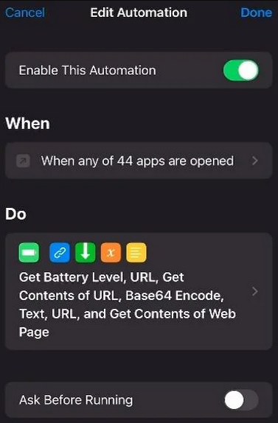
Persistence: Shortcuts Αutomation
Triggered by opening social media and messaging apps
Ensures that battery percentage > 9%
Downloads (undiscovered) malicious JavaScript code from the server
Substitutes the JS code into the HTML of the shortcut
JS code invokes XSLT transformation already in HTML when run
Encodes HTML as Base64
Passes encoded URL to the WebKit engine to render
Triggers exploit to install Predator's later stages
Shortcut runs in the background while invisible without showing notifications

Slide 13
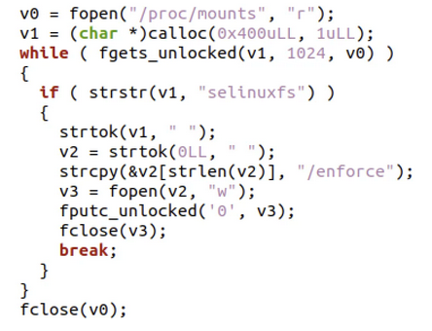
Exfiltration
Android
iOS
Attempts to disable SELinux
injector module injects audio rec shared objects (recorder, voip_recorder) into a running process
pc2 module sends IPC hot commands (START_VOIP, STOP_VOIP, START_MICRORECORDER, STOP_MICRORECORDER, and POLL_VOIP) to injected audio rec components
Stores recordings at /data/local/tmp/wd/r/ in MP3 format
Launches malicious processes hooker and takePhoto in the same launchd coalition (BackgroundShortcutRunner) with the illegitimate processes UserEventAgent and Webkit.Networking when the shortcut automation is triggered
hooker process presumably intercepts the communication of software components and alters their behavior
takePhoto process presumably captures camera data
Sends exfiltrated data to gosokm[.]com

Slide 14
Detection & Recovery
Detection of Predator is possible through the following Indicators of Compromise (IOC):
Device is unreasonably running hot, as reported by victims of Predator
Suspicious processes and binaries not developed by Apple were run or launched when a URL was visited
Traces of domains known to belong to Cytrox. Any of the IPs and 600+ combined URLs specified by CitizenLab, Meta and WhoisXML are potential IOCs
Recovery after being infected with Predator can be achieved by:
Doing a factory reset of the infected device
Updating the device’s operating system
Updating exploited apps when their vulnerabilities are patched (although new 0-days may be exploited as part of Predator's 12-month warranty)

Slide 15
Bibliography
citizenlab.ca. (2021). Pegasus vs. Predator: Dissident’s Doubly-Infected iPhone Reveals Cytrox Mercenary Spyware. [online] Available at: https://citizenlab.ca/2021/12/pegasus-vs-predator-dissidents-doubly-infected-iphone-reveals-cytrox-mercenary-spyware/ [Accessed 6 Dec. 2022].
Google. (2022). Protecting Android users from 0-Day attacks. [online] Available at: https://blog.google/threat-analysis-group/protecting-android-users-from-0-day-attacks/ [Accessed 9 Dec. 2022].
Meta. (2021). Taking Action Against the Surveillance-For-Hire Industry. [online] Available at: https://about.fb.com/news/2021/12/taking-action-against-surveillance-for-hire/.
WhoisXML. (n.d.). Predator Surveillance Software May Not Be Lawful at All | WhoisXML API. [online] Available at: https://main.whoisxmlapi.com/threat-reports/predator-surveillance-software-may-not-be-lawful-at-all [Accessed 9 Dec. 2022].
The New York Times. (2022). Read the Intellexa Pitch on Its Spyware Tool. [online] 8 Dec. Available at: https://www.nytimes.com/interactive/2022/12/08/us/politics/intellexa-commercial-proposal.html [Accessed 12 Dec. 2022].
www.threatfabric.com. (n.d.). Alien - the story of Cerberus’ demise — ThreatFabric. [online] Available at: https://www.threatfabric.com/blogs/alien_the_story_of_cerberus_demise.html [Accessed 9 Dec. 2022].
TryHackMe. (n.d.). TryHackMe | Metasploit: Introduction. [online] Available at: https://tryhackme.com/room/metasploitintro [Accessed 14 Dec. 2022].

